Slide 1

Binary Bandits
Operation ShadowTrace
Notes:
Hello, this is Stephen Chao, “I am Jon Luhmann”, “I am Cody Pridgeon”, and we are the Binary Bandits. Firstly, we wanted to thank Fullstack Academy and it’s teaching staff for all the things we learned in this 3 month bootcamp program. A lot of us came in with little to no cyber experience and learned a great deal in just a short amount of time. While we covered everything from learning how to code in Python to configuring and maintaining a network, we appreciated the camaraderie between the students and the time and patience of the teaching staff given to us through exercises and checkpoints.

Slide 2
Table of Contents:
Red Team - Phishing Email
SSH into target
Installing the Keylogger
Blue Team - Checking Users
System Admin Catches Bad Actor
Investigate the User
Scan the Computer
Wireshark - Suspicious Packet Captures
Updating Firewall Permissions
Eliminate Bad Actor
Remove Malicious Files
Proof of All Clear
Sources
Notes:
In this presentation, we will show how a target unknowingly shares his private key to an attacker through a phishing email. Next, our attack will compromise the target’s computer through the installation of a Keylogger. If this were a real life situation, this keylogger could be set up to only activate when the target enters their banking application, credit card app, etc. A cron job would be set up to send log files to the host without attracting attention. However, in our example, we are going to purposely get caught. We will then show how to remove malicious files, unidentified users and prevent our bad actor from accessing our system via firewall IP address blocking.

Slide 3
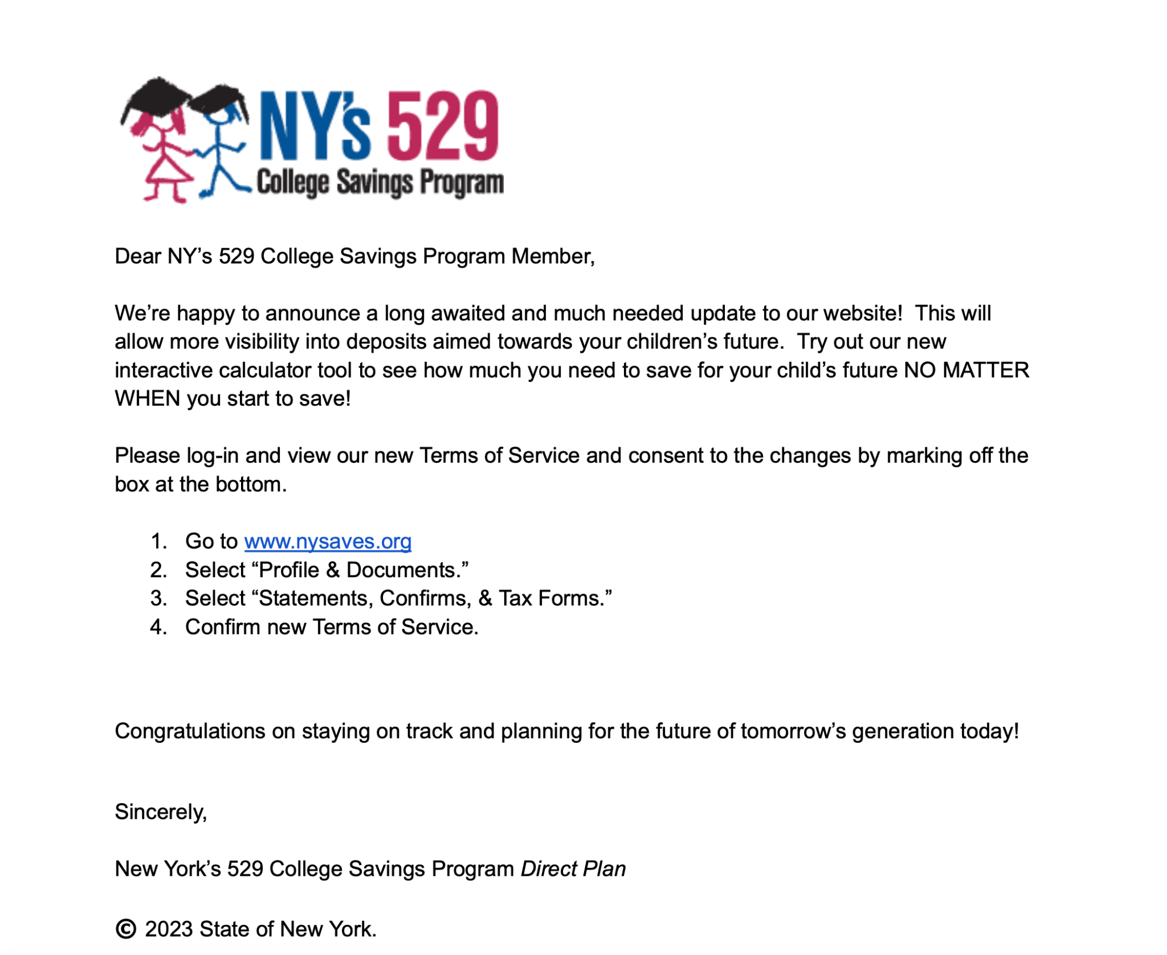
Phishing Email
Notes:
We all get emails. Some of us receive a few, while others receive hundreds each and every day. With attackers becoming more and more proficient with how they present their emails, it becomes harder and harder to determine real ones from the fake ones. While this email may look and read like a real email, this is in fact a phishing attempt meant to acquire a target’s vital information including their cookies, passwords, etc. By clicking this link, our attacker was able to acquire the target’s private key. The private key allows access to the host computer to create, delete, and even access secret files!

Slide 4

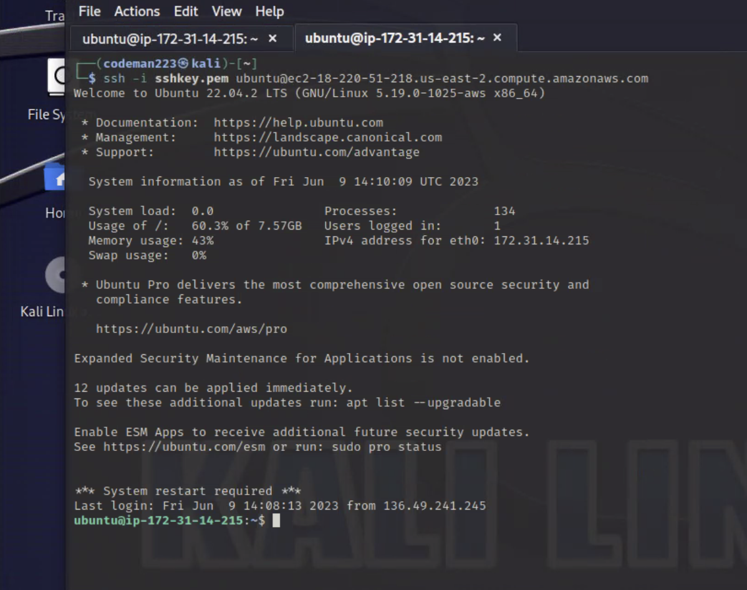
SSH into Target
Notes:
In Lesson 3 of Fullstack Cyber Bootcamp, we were taught how to use Linux commands to log-in remotely to someone else’s computer. In this case, the attacker was able to log into the target’s computer using the private key stolen after the target unknowingly clicked the link in the phishing email. At first it looks innocent, but if this target didn’t password protect his files and/or password protect the root account, this attacker might be able to completely compromise the system!

Slide 5
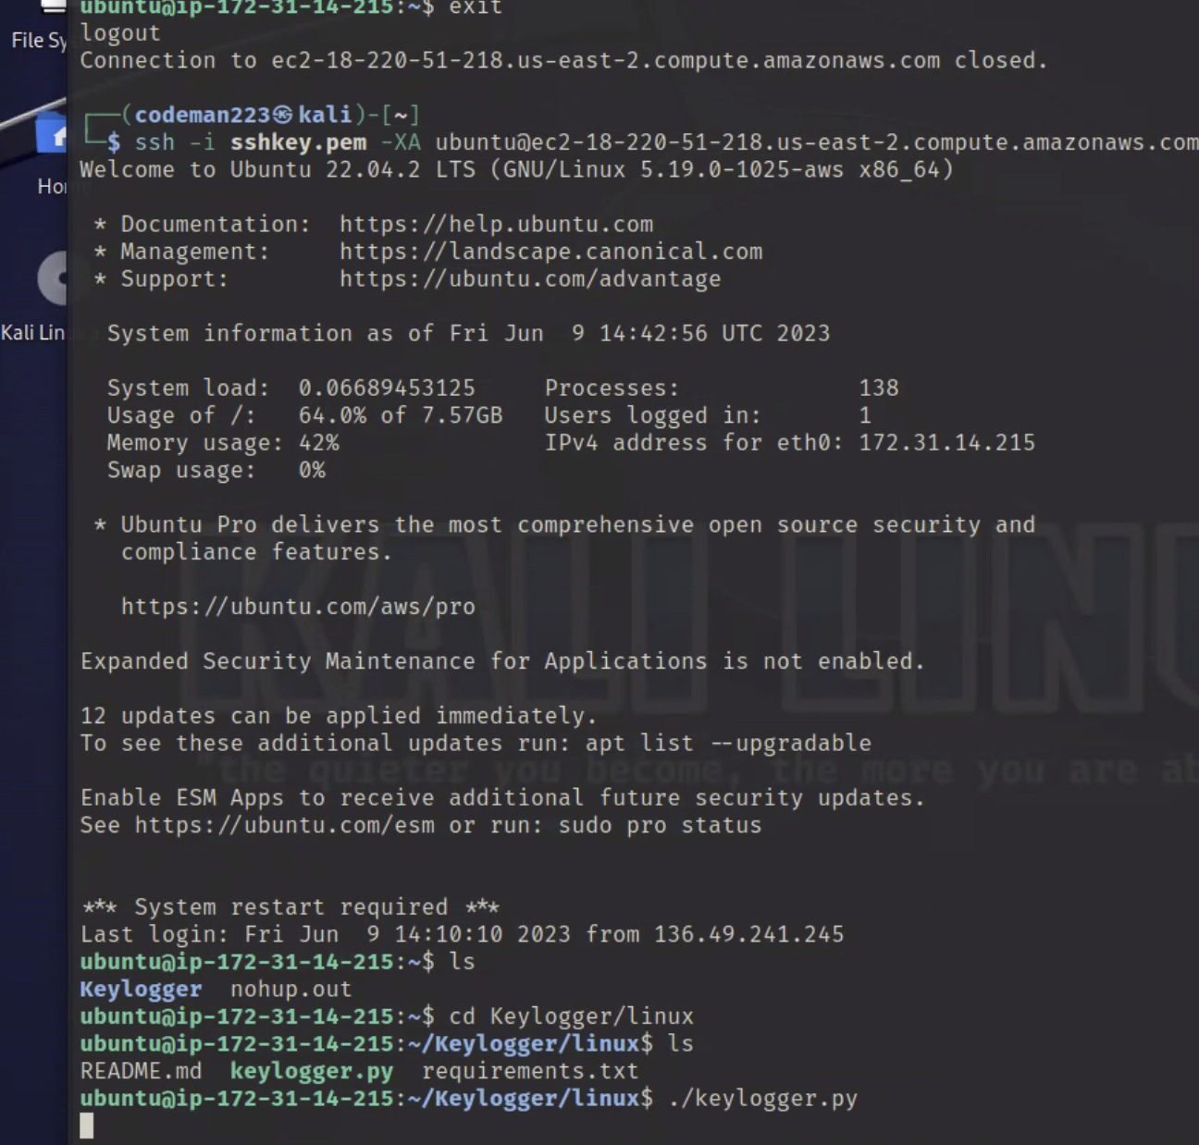
Installing the Keylogger
Notes:
It appears that our attacker was able to create a super user account named “adminotaur”. A super user is a user that can access all the files as a “root” user. Additionally, the “root” user has special privileges that supersedes any user or group. This will allow our attacker to create, delete, and install files onto the target computer without having to know the passcode. In this case, our attacker intends to install a keylogger and perhaps wait until the target shares some private information such as the passwords to his financial accounts.

Slide 6
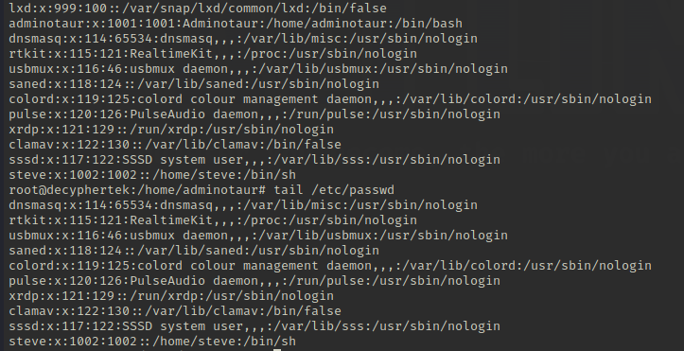
Checking for Users
Notes:
The etc/passwd file shows the username, encrypted password, and the User ID of each user on the computer. We used the cat command on the etc/passwd file and noticed a user named “Adminotaur.” They immediately became suspicious. We’ve apparently been compromised. We realized the need to bring in a professional so we hired a System Administrator to help up get to the bottom of what was happening on our system.

Slide 7
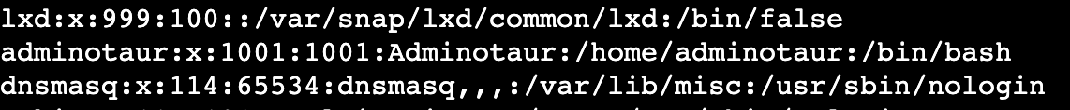
System Admin Catches Bad Actor
Notes:
Our SysAdmin must now go ahead and learn as much about our bad actor as possible. What other processes may “Adminotaur” be running? What privileges do they have? Our SysAdmin realized there is no hashed password on “Adminotaur’s” user account and that they have their own home directory as well. Now that we’ve found our culprit, our SysAdmin would like to check out what other processes “Adminotaur” may be running.

Slide 8
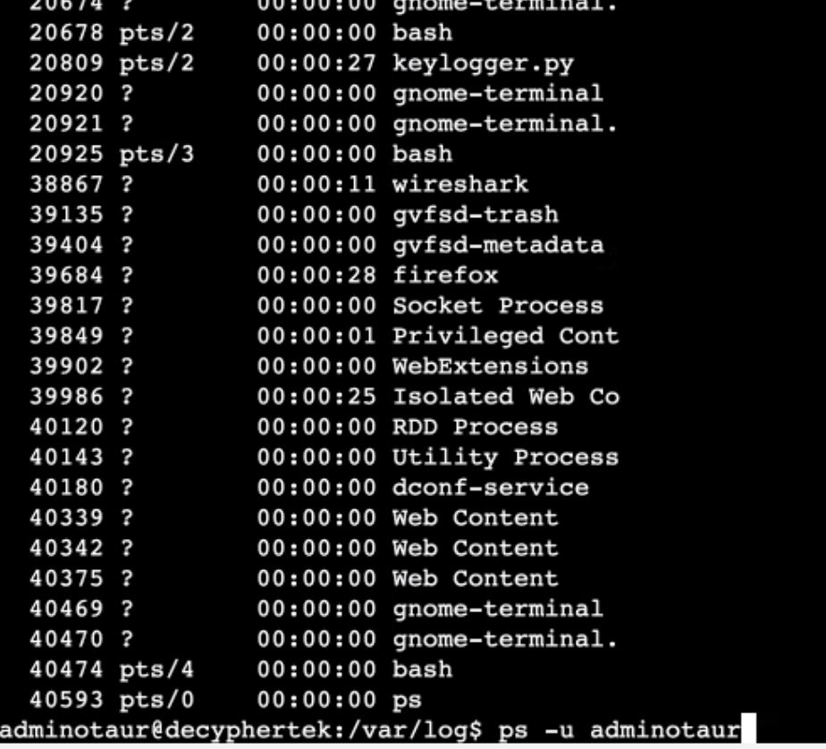
Investigate the User
Did a ps-u command to show keylogger program running from user Adminotaur
Notes:
Luckily, our SysAdmin retained sudo privileges. By entering the “ps -u adminotaur” command, our SysAdmin displayed a list of running processes. Taking a look at these processes gives us more information. Our SysAdmin noticed the bad actor was running a process called keylogger.py. This looks suspicious. Clearly this malicious piece of software shouldn’t be on our system. What else can our SysAdmin find?

Slide 9
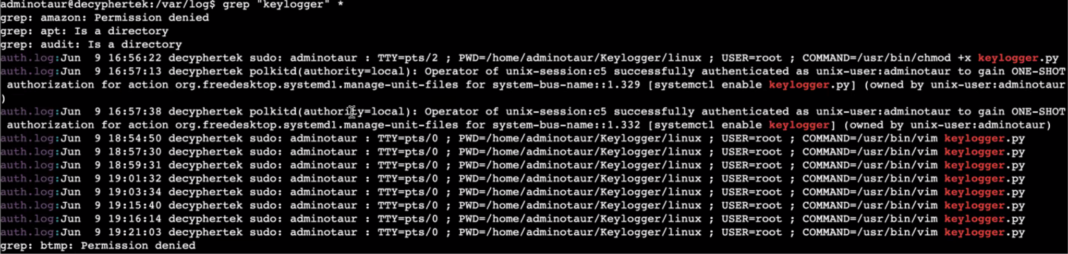
Scan the Computer
Notes:
The systemctl command allows the SysAdmin to manage and control what programs are running on the Operating System. Our SysAdmin used the systemctl command and found that the keylogger.py was enabled, meaning it runs on system start up each time. They noticed that “Adminotaur” installed a keylogger using Sudo, meaning they have root privileges and have access to the same permissions as the administrator account on our system. This is a catastrophic realization. With root access, there’s no limit to what Adminotaur can do.

Slide 10
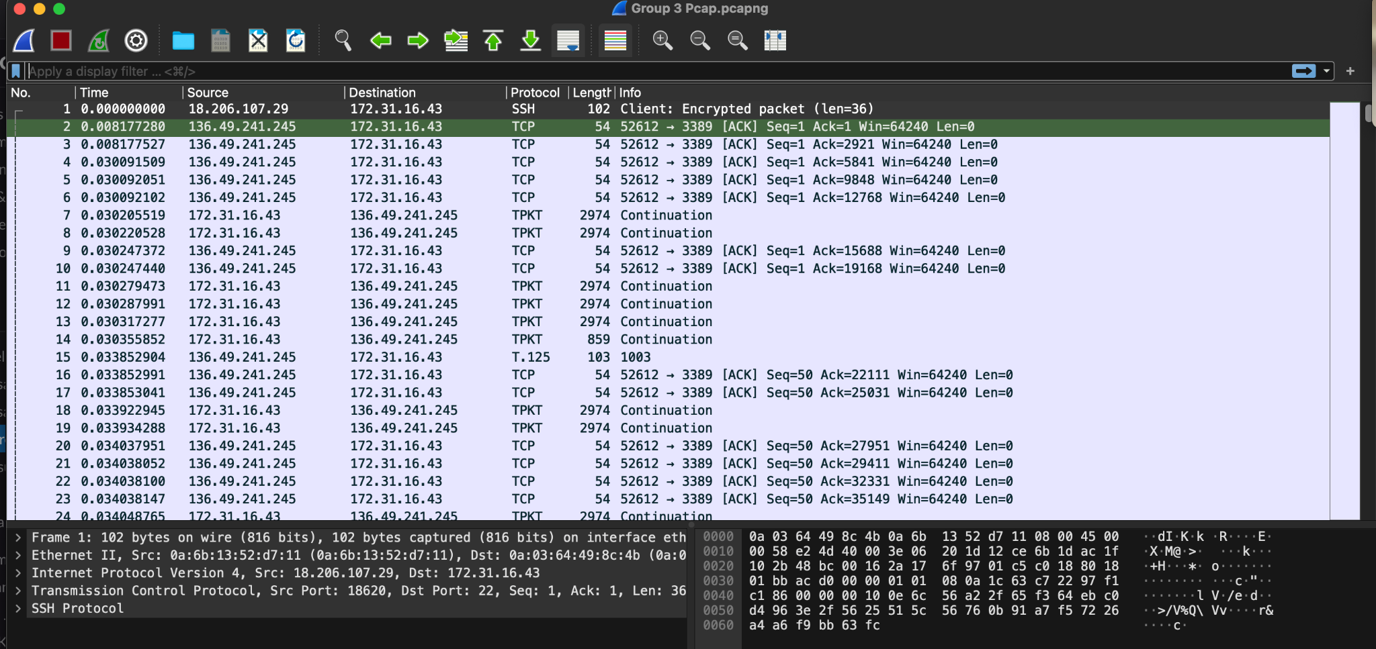
Wireshark
Notes:
Wireshark is a Network Protocol Analyzer that captures packets from a network connection. It breaks down each connection on a granular level. Using Wireshark, our SysAdmin was able to identify the IP address of Adminotaur who ssh’d into our system on port 22. They were then able to take that information and add it into our firewall rules to block any further unauthorized access from this user’s IP address. This is a start to recovering our system from the bad actor, but there is still more that needs to be done.

Slide 11
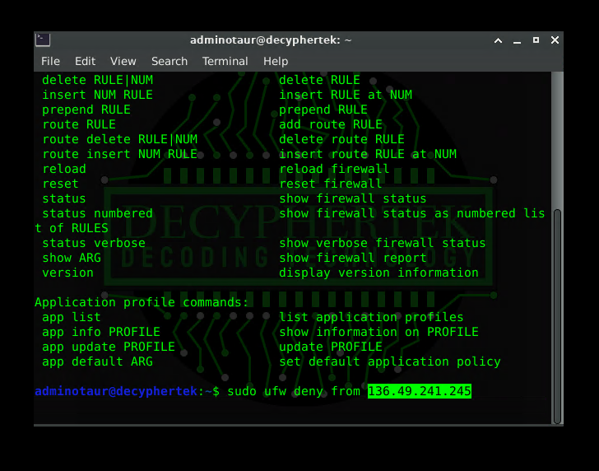
Updating Firewall Permissions
Notes:
Every safe system configuration contains at least one firewall. A Firewall provides protection from outside cyber threats by shielding your system from malicious network traffic. An effective firewall should be kept up to date. This includes filtering out unidentified IP Addresses. Our SysAdmin entered the code into the command line to block the suspicious IP address in our UFW Firewall. Now any further activity from this IP address will be blocked from engaging with our system. This is a crucial step to remedy the infiltration and in preventing this type of event from occurring again.

Slide 12
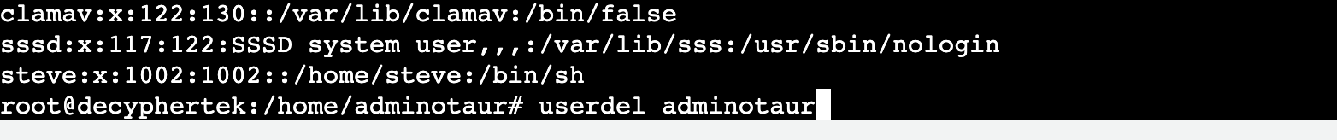
Eliminate Bad Actor
Notes:
Now that the bad actor’s IP address has been blocked, it’s time to start cleaning up the damage. Our SysAdmin was able to regain control of our system by removing the bad actor “Adminotaur” from the list of user accounts. Had the attacker changed the password of the root account, we would have lost the ability to remove the bad actor from our list of users. In this case the only solution would be to load the hard drive from a backup image. It is imperative that backup’s are maintained in a variety of ways. They should be a combination of both external hard drives coupled with cloud based backups.

Slide 13
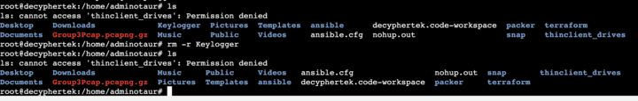
Remove Malicious Files
Notes:
Our SysAdmin shows how the Keylogger directory and its contents were removed from our machine. A thorough knowledge and understanding of Linux and its commands are needed to make sure the machine is cleaned up and the malicious software is removed. Just to ensure it was removed successfully, the SysAdmin ran the ls command within the same directory the keylogger file was installed in. Poof! It’s gone. The final task that needs to be completed is using the grep command to make sure there are no traces of the keylogger remaining on the file system.

Slide 14
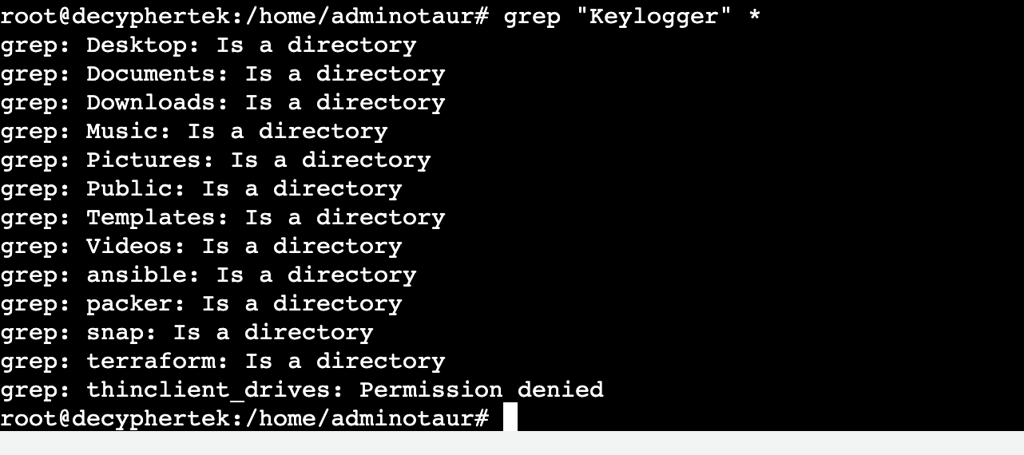
Proof of All Clear
Notes:
After using the grep command, we found there is no longer a trace of the keylogger. Mission accomplished! Now, the SysAdmin and their team will have to sit down and come up with added security features to further protect themselves from the same type of event. NO system is 100% secure. By patching as many vulnerabilities as possible, and continuously thinking of new potential problem areas, the SysAdmin can put forth their best efforts at making sure the system isn’t compromised in the same way.

Slide 15
Sources:
Chat GPT 3.5- “Keylogger” 6/9/2023 https://www.https://chat.openai.com/
Wireshark- 4.0.6 6/9/2023
Amazon Web Services- Ubuntu 22.04 LTS XFCE Desktop -Ultimate SysAdmin
Remmina- Remote Desktop Client: V 1.4.29
Kali Linux- Ubuntu 22.04 LTS “Jammy Jellyfish”
Notes:
Thank you for listening to our presentation. We hope you all learned something new. If you already knew everything we showed you today, consider this lesson as a refresher. If you are interested in finding out more about keyloggers or wireshark, you can use Chat GPT of google. We also recommend practicing with AWS. They have heaps and heaps of servers just waiting to spin up your own private instance. There are a lot of resources out there, you just need to know where to look.

